Slide 1
Introduction to Quantum Computing
Seminar 1

Slide 2
Before going in…
I am also a beginner in this field…
If you are interested, you can search more using:
Quantum Computing since Democritus (Scott Aaronson)
Quantum Computation and Quantum Information (Nielsen & Chuang)
Quantum Computer Science: An Introduction (David Mermin)

Slide 3
Before going in…
Nielsen & Chuang is considered as the standard text. This presentation is based on Nielsen & Chuang.
Though primarily based on the first part of the book, I shall add some details.
I reckon that I distributed the files before this seminar.
Today, let’s discuss the basics.
Hmm.. will I be able to cover this whole presentation in 50 min?

Slide 4
Schedule
1. Introduction to Quantum Computing - Today
2. Some Formalisms in Quantum Mechanics
3. Quantum Computations
4. Realisations of Quantum Computers
5. Quantum Noise, Operations, and Distances
6. Error Corrections
7. Quantum Entropy & Information Theory
* Unfortunately, I should study from topic 4.

Slide 5
Qubits
Don’t be confused: Quantum bits are “Mathematical” objects – we need to incorporate those into the real physical world.
Think it as the quantum ket: |ψ⟩ = α |0⟩ + β |1⟩.
The special states |0⟩ and |1⟩ are known as computational basis states, and form an orthonormal basis for this vector space.
I will assume that you know how to interpret this state.

Slide 6
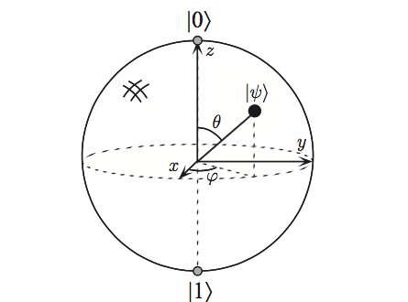
Bloch Sphere
Rewrite |ψ⟩ = α |0⟩ + β |1⟩ to |ψ⟩ = cos θ|0⟩ + exp(iφ) sin θ|1⟩
The two angular variables define a sphere (The Bloch Sphere)
How much information is stored in one qubit?

Slide 7

Multiple Qubits
|ψ⟩ = α00|00⟩ + α01|01⟩ + α10|10⟩ + α11|11⟩. For two qubits.
Quite straightforward!
Ex. What if we measured the first qubit and retrieved 0? What is the state then?
Ans: $\frac{a_{00}\left|0\left.0\right\rangle \right.+a_{01}\left|0\left.1\right\rangle \right.}{\sqrt{{\left|a_{00}\right|}^{2}+{\left|a_{01}\right|}^{2}}}$
We can generalise this to n qubits!

Slide 8

Single Qubit Gates
The NOT Gate: X≡$\left[\begin{matrix}0 & 1 \\ 1 & 0\end{matrix}\right]$ This is little different from the classical analogue…
The Z Gate : Z ≡$\left[\begin{matrix}1 & 0 \\ 0 & −1\end{matrix}\right]$
The Hadamard Gate: H ≡$\frac{1}{\sqrt{2}}\left[\begin{matrix}1 & 1 \\ 1 & −1\end{matrix}\right]$
Note. Single Qubit Gates must still maintain the normalisation conditions: Must be a Unitary operator!

Slide 9
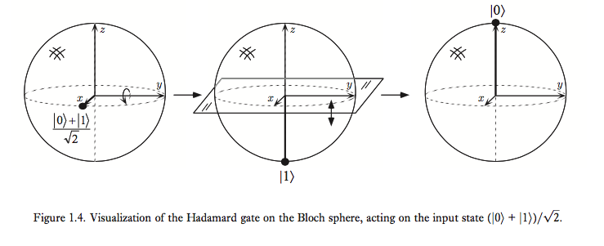
Visualisation on the Bloch Sphere

Slide 10

Arbitrary Single Qubit Gates
Note that the operation is a rotation on the Bloch Sphere.
Property of the SU(2) Group: An arbitrary gate can be represented by a product of finite number of other gates as $U=e^{ia}\left[\begin{matrix}e^{−iβ/2} & 0 \\ 0 & e^{iβ/2}\end{matrix}\right]\left[\begin{matrix}cos\frac{γ}{2} & −sin\frac{γ}{2} \\ sin\frac{γ}{2} & cos\frac{γ}{2}\end{matrix}\right]\left[\begin{matrix}e^{−iδ/2} & 0 \\ 0 & e^{iδ/2}\end{matrix}\right]$
Look Sakurai Ch. 3 or Nielsen Ch 4 for further details.

Slide 11
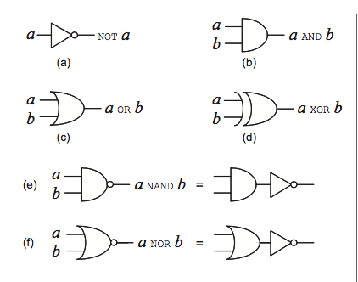
Multiple Qubit Gates
Some Examples of Classical Gates: AND, OR, XOR, NAND, NOR (Look at the Figure below)
We shall see whether these gates can be represented in Quantum Computing.

Slide 12
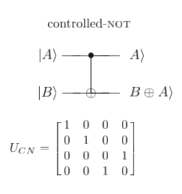
The CNOT Gate
The Controlled-NOT gate functions as follows:
There are two inputs: One is the control and other is the target.
If Control=0 : Nothing happens.
If Control=1 : Target is flipped.

Slide 13
The CNOT Gate
The CNOT gate is the modulo 2 computation for Qubits, just as XOR gates do in classical counterparts.
The CNOT gate is the generalisation of XOR gates.

Slide 14
Other Classical Gates
Question: As we have seen a generalisation of XOR, do we have the counterparts for other classical gates?
Answer: No. Can we determine the initial states by looking at the final output? (Reversible vs Irreversible)
Note. Quantum gates must be unitary!

Slide 15
Universality
Thm. Any multiple qubit logic gate may be composed from CNOT and single qubit gates.
Similarily, any classical logic gate may be composed form NAND gates. XOR or NOT does not. Think of parity.

Slide 16

Measurements in bases other than the computational bases
TL;DR : Yes we can.
|ψ⟩ = α|0⟩ + β|1⟩ =$\frac{α+β}{\sqrt{2}}\left|\left.+\right\rangle \right.$+ $\frac{α−β}{\sqrt{2}}\left|\left.−\right\rangle \right.$, where the + and – kets are the bases for the x direction in spins.
It is possible in principle to measure a quantum system of many qubits with respect to an arbitrary orthonormal basis. Just as we do in QM!
Stern-Gerlach Experiment

Slide 17
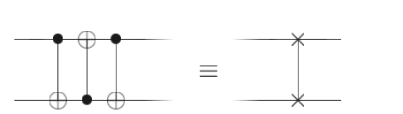
Quantum Circuits
With the gates we have learnt, now let’s construct a ‘circuit’ to do some specific tasks.
Look at the circuit below. The ’wire’ need not represent the physical connection, but rather the flow of time.

Slide 18
Some Rules on Constructing Circuits
It’s quite the same with how we do on classical computing, but we have some more restrictions.
1. No Loops – the wires are connected by TIME!
2. No joining of wires (FANIN): This is irreversible.
3. No Split of wires (FANOUT): We CANNOT copy qubits!

Slide 19
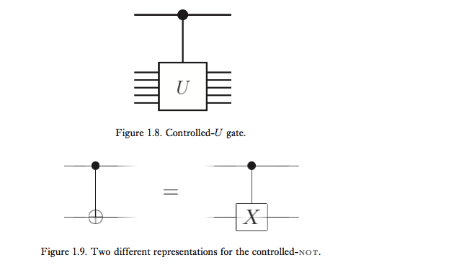
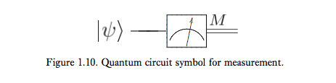
Example
What does this circuit do? Try it out!
Cf) All circuits start at 00000…

Slide 20
The No-Cloning Theorem
This is a rather easy proof, so I shall state here
Suppose a Quantum Machine that has two Slots A and B; A is the data slot and B is the target slot.
Both start as a pure Quantum state |ψ > and |s> .

Slide 21



The No Cloning Theorem
Some Unitary evolution that clones the data slot is now applied:
Suppose this procedure works for two states (I didn’t say the two are different!)
Take the Inner Product of the two equations above:

Slide 22
The No Cloning Theorem
The machine can only copy states that are either: 1. Identical or differs by a phase factor 2. Are orthonormal to each other.
-> General Cloning Machines are impossible!
What if non-unitary? What if impure?...
I shall present on the Mixed Ensembles next time.

Slide 23
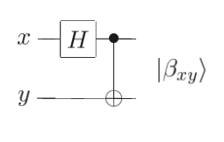
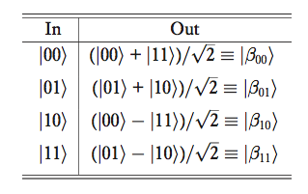
More Advanced Example 1: Bell States
Calculate the outputs for the following circuit.
Look Ch 12 in Griffiths or Ch 3.10 in Sakurai for further details.

Slide 24
More Advanced Example 2: Quantum Teleportation
Both Alice and Bob generated a EPR pair, and took one qubits each.
Alice then wants to send her qubit |ψ⟩ (not the EPR pair but the information) but she does NOT know the state of her qubit and can only send classical information.
Note: Since the qubit is on continuous Bloch sphere, sending all the information even if she knew the state will take forever. Also, by the No Cloning Theorem, she cannot copy the qubit.

Slide 25
More Advanced Example 2: Quantum Teleportation
An Overview: Interact Alice’s qubit with the EPR state she has.
Then, she shall send the classical results (00, 01, 10, 11) to Bob.
Depending on the results, Bob shall perform different operations on his EPR state.
Let’s look more deeply in the next slide.

Slide 26
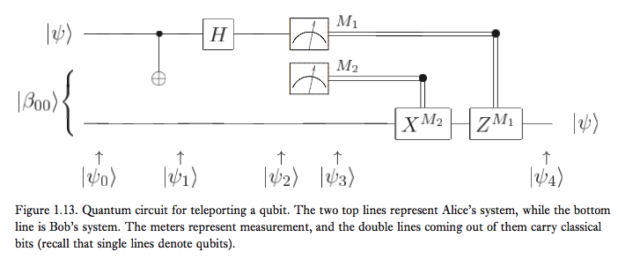
More Advanced Example 2: Quantum Teleportation

Slide 27

Explanations
|ψ⟩ = α|0⟩+β|1⟩: State to be Teleported (both coefficients unknown)
The state input into the circuit |ψ0⟩ is |ψ0⟩ = |ψ⟩|β00⟩ =$\frac{1}{\sqrt{2}}$(α|0⟩(|00⟩ + |11⟩) + β|1⟩(|00⟩ + |11⟩))
(First two qubits: Alice’s, third qubit: Bob’s)
Follow the Instructions! -> Apply the CNOT gate to Alice’s Qubits
$\frac{1}{\sqrt{2}}$(α|0⟩(|00⟩ + |11⟩) + β|1⟩(|10⟩+|01⟩))

Slide 28
Explanations
First Qubit through the Hadamard Gate: ½(α(|0⟩ + |1⟩)(|00⟩ + |11⟩) + β(|0⟩ − |1⟩)(|10⟩ + |01⟩))
Regroup the terms so that Alice’s two qubits are represented together: ½(|00⟩ (α|0⟩ + β|1⟩) + |01⟩ (α|1⟩ + β|0⟩) + |10⟩ (α|0⟩ - β|1⟩) + |11⟩ (α|1⟩ - β|0⟩) )
By Alice measuring the state, Bob’s state is determined. However, since we have 4 possibilities, Alice must send her measurement results to Bob.
Question: Is this a violation of the No Cloning Theorem?

Slide 29
Classical Computations in Quantum Computers
Quantum vs Classical = Unitary vs Non-Unitary (Reversibility)
However, any classical circuit can be replaced by an equivalent circuit containing only reversible elements.
Any ideas on how to do this?

Slide 30
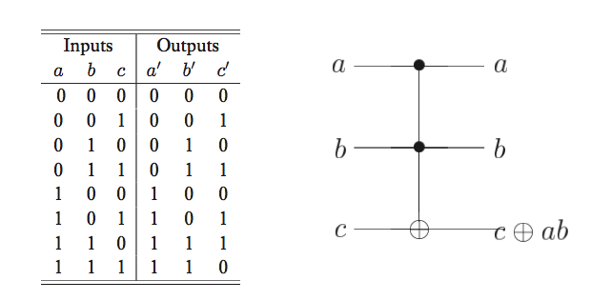
The Toffoli Gate
This is essentially close to a CNOT gate, but it has two inputs!

Slide 31
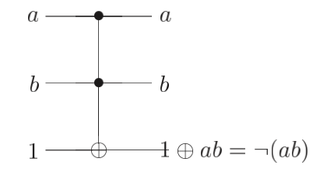
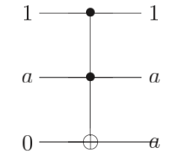
Simulation of NAND and FANOUT in Quantum Computing
NAND
FANOUT

Slide 32
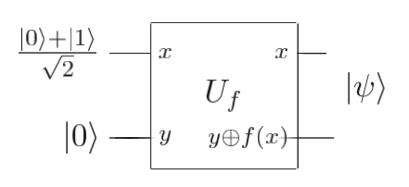

Representing a Function in Quantum Algorithms
With an appropriate sequence of logic gates it is possible to transform |x, y⟩ into |x, y ⊕ f (x)⟩ .
If y = 0, then the final state of the second qubit is just the value f (x).
Result: $\frac{1}{\sqrt{2}}$(|0,f(0)⟩+|1,f(1)⟩)
The different terms contain information about both f(0) and f (1), as if we evaluated different values of f simultaneously.

Slide 33
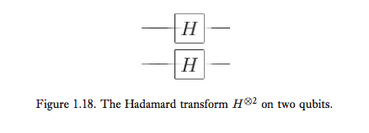

Walsh-Hadamard Transform
Generalisation to n qubits
Obviously, the result if prepared with the initial state of 0 shall be (|00⟩+|01⟩+|10⟩+|11⟩)/2
Parallel Action to n gates: Tensor!
Combine the result of the transform and one more 0 state to Uf: $\frac{1}{\sqrt{2^{n}}}\sum_{x}{\left|\left.x\right\rangle \right.\left\langle \left.f(x)\right|\right.}$

Slide 34
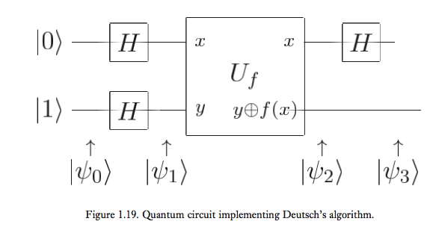
The Deutsch Algorithm

Slide 35
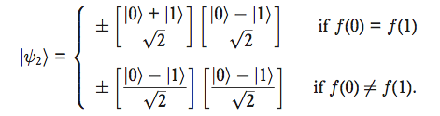

The Deutsch Algorithm
Input: |ψ0⟩ = |01⟩
Passes the Hadamard gate: |ψ1⟩ =((|0⟩+|1⟩)/ √2 )(|0⟩−|1⟩ )/ √2
Note. If we apply Uf to |x⟩(|0⟩ − |1⟩)/√2 then we obtain the state ${(−1)}^{f(x)}\frac{1}{\sqrt{2}}$(|x⟩(|0⟩ − |1⟩)).

Slide 36
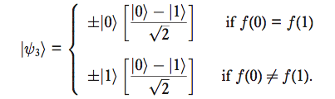

The Deutsch Algorithm
Final Step: Apply the Hadamard Gate once again.
Since f (0) ⊕ f (1) is 0 if f (0) = f (1) and 1 otherwise, rewrite this as |ψ3⟩ = ±|f(0) ⊕ f(1)⟩$\frac{\left|\left.0\right\rangle \right.−\left|\left.1\right\rangle \right.}{\sqrt{2}}$
We can get the values for f with one calculation!

Slide 37
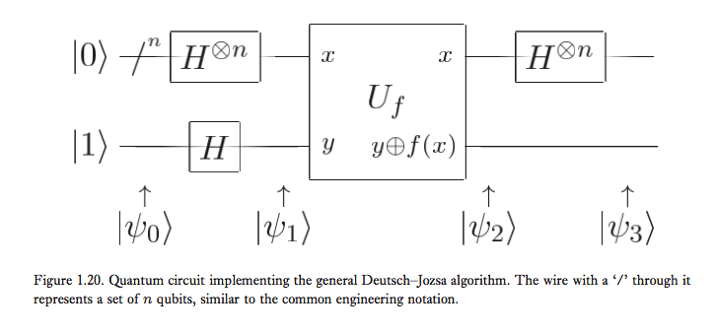
Generalisation: The Deutsch-Jozsa Algorithm
Simple. This (on the right) was for two separate states.
Do it on n states!

Slide 38
Generalisation: The Deutsch-Jozsa Algorithm
The algorithm is the solution to the following problem (Deutsch’s Problem)
Alice, in London, selects a number x from 0 to 2^n − 1 , and mails it in a letter to Bob, in New York.
Bob calculates some function f(x) and replies with the result, which is either 0 or 1.
either f(x) is constant for all values of x, or else f(x) is balanced, which means that 0 and 1 appears in equal probability.
Goal: determine with certainty whether Bob has chosen a constant or a balanced function. How fast can she do?

Slide 39
Generalisation: The Deutsch-Jozsa Algorithm
Classical: Srsly, we need to calculate exponential amount of data…
Quantum: We are good to go in one attempt!

Slide 40
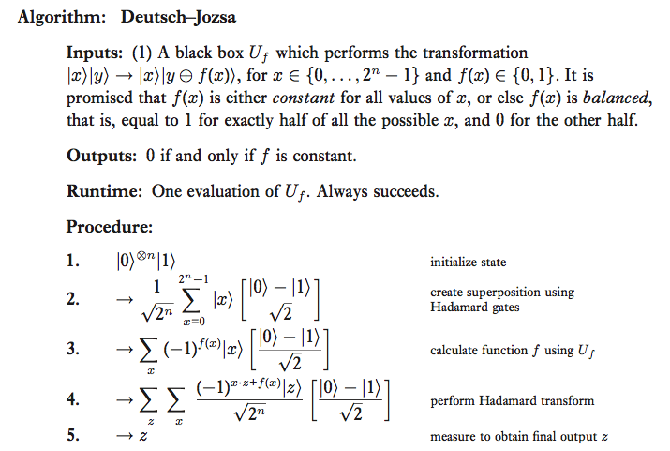
Generalisation: The Deutsch-Jozsa Algorithm
Classical: Srsly, we need to calculate exponential amount of data…
Quantum: We are good to go in one attempt!

Slide 41
Generalisation: The Deutsch-Jozsa Algorithm
Few Caveats though exist:
1. What if we just use a probabilistic classical computer? Few trial and error will be sufficient.
2. The Deutsch Problem does not have any practical applications.

Slide 42
Other Quantum Algorithms
Deutsch-Jozsa Algorithm/Shor Algorithm
Fourier Transforms (Quantum Version of the FFT!)
Quantum Search Algorithms
Quantum Simulations
Later!

Slide 43
Computational Complexity Theory
P: class of computational problems that can be solved quickly on a classical computer
NP: class of problems which have solutions which can be quickly checked on a classical computer
PSAPCE: problems which can be solved using resources which are few in spatial size, but not necessarily in time -> Assumed to be larger than P and NP but never proved
BPP: class of problems that can be solved using randomized algorithms in polynomial time, if a bounded probability of error is allowed in the solution to the problem.
BQP: Analogue of BPP in Quantum Computing.

Slide 44
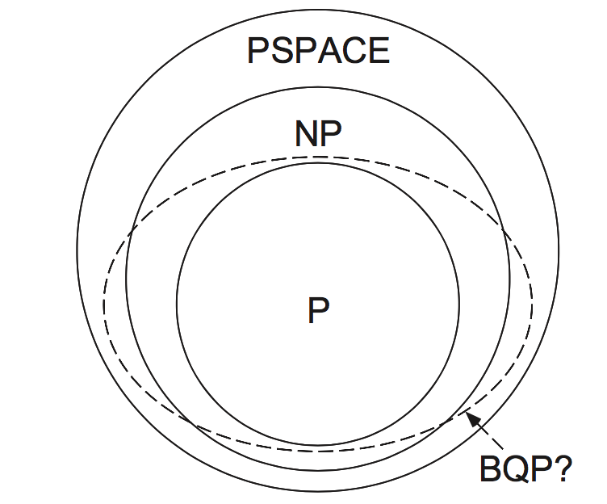
Computational Complexity Theory
P: class of computational problems that can be solved quickly on a classical computer
NP: class of problems which have solutions which can be quickly checked on a classical computer
PSAPCE: problems which can be solved using resources which are few in spatial size, but not necessarily in time -> Assumed to be larger than P and NP but never proved
BPP: class of problems that can be solved using randomized algorithms in polynomial time, if a bounded probability of error is allowed in the solution to the problem.
BQP: Analogue of BPP in Quantum Computing.

Slide 45
Stern-Gerlach Experiment
We all know what this experiment is meant to show ☺
Is this experiment compatible with the Qubit Model?
What about electron spin being a proof that qubits can exist and be realised in the real world?

Slide 46
Possibility of Realisations in the Physical World
Problem with Noise: Are there any fundamental obstacles (noises) which shall prevent the realisation?
What if QM is wrong?
How can we make this ‘excellent’ thing running in the real world? NMR? Ion Trap?

Slide 47
Quantum Information
Quantum Information focuses on the following three objectives. (Primarily. Of course, this isn’t it!)
1. Identify elementary classes of static resources in quantum mechanics.
2. Identify elementary classes of dynamical processes in quantum mechanics.
3. Quantify resource tradeoffs incurred performing elementary dynamical processes.

Slide 48

The Shannon Entropy
The formula is given as $H\left(p_{j}\right)=−\sum_{j}{p_{j}logp_{j}}$, where p_j represents the probability for each state j.
Think of a coin toss: In what probability distribution will the system have the maximum entropy?
Cf) This concept is applied in statistical mechanics, especially considering the complex systems.

Slide 49
Some theorems in Quantum Information
The Noiseless Coding Theorem
The Noisy Channel Coding Theorem
Schumacher’s Noiseless Channel Coding Theorem
So on and so on…
The implications are quite hard; let’s look these on a latter time.

Slide 50
Quantum Distinguishability
The rules of QM makes us impossible to distinguish between arbitrary states (kets).
For example, if we measured l1>, can we know what exact state was the measurement derived from?
Quantum state contains information that CANNOT be accessed by measuring: important in Cryptography!

Slide 51
Quantum Distinguishability
What if we can distinguish non-orthogonal states?
1. Using EPR pairs, faster-than-light communications are feasible.
2. We can make a cloning machine!

Slide 52
Entanglements
We still don’t know very well abt entanglements…
How many qubits must two parties exchange if they are to create a particular entangled state shared between them, given that they share no prior entanglement?
Can we transform entanglement from one form into another?

Slide 53
Acknowledgements
The overall text was amended using Nielsen & Chuang, Quantum Computations and Quantum Information, 10th anniversary edition, Cambridge University Press, 2010.
The figures used in this presentation is also an excerpt from Nielsen and Chuang.
This presentation is NOT intended for commercial uses, but for education.

